Slide 1
Regression with Regularization II
Statistical Data Analysis, 2023

Slide 2
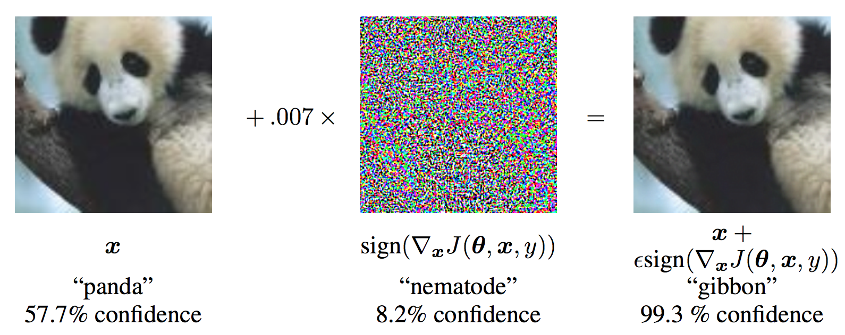
Model: GoogLeNet (Szegedy et al., 2014) on ImageNet.
Keyword: Adversarial example

Slide 3
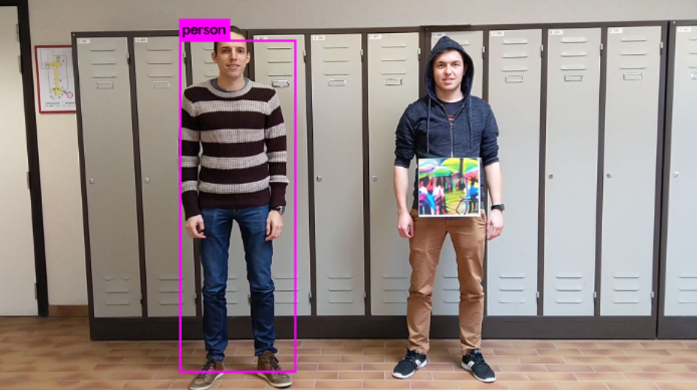
“Fooling automated surveillance cameras: adversarial patches to attack person detection”, S. Thys, et al, 2019

Slide 4
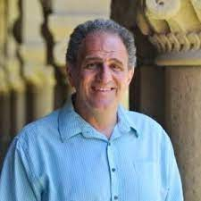
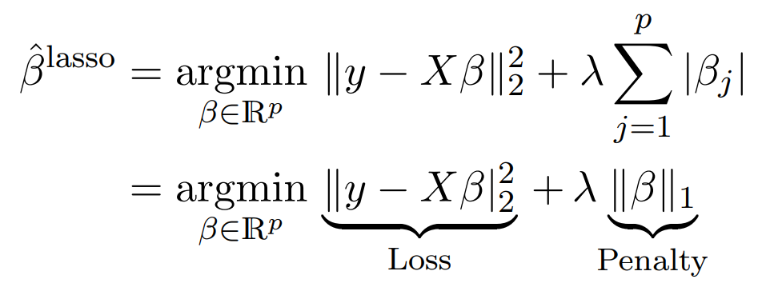
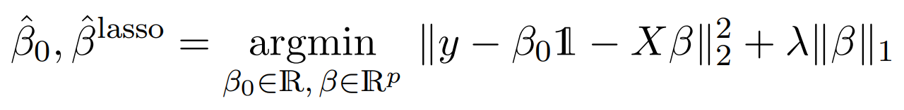
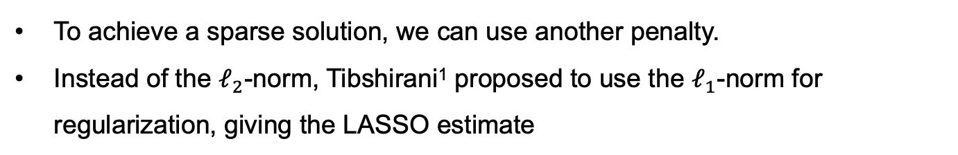
The LASSO
To achieve a sparse solution, we can use another penalty.
Instead of the $ℓ_{2}$-norm, Tibshirani¹ proposed to use the $ℓ_{1}$-norm for regularization, giving the LASSO estimate
Robert Tibshirani,
(1956 – )
With the intercept term:
¹Tibshirani (1996), “Regression Shrinkage and Selection via the Lasso”
The name of LASSO really tells what it does:
Least Absolute Selection and Shrinkage Operator

Slide 5
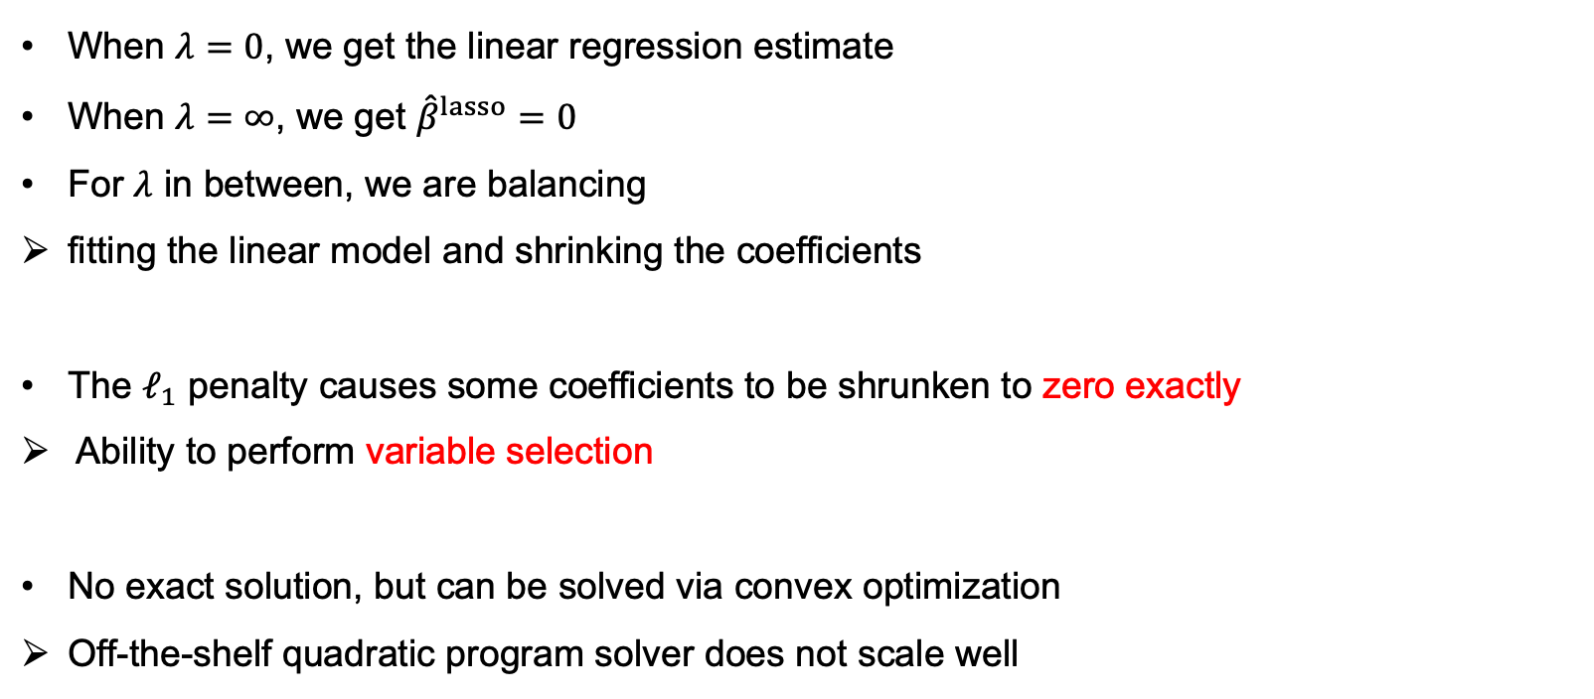
The LASSO
When $λ=0$, we get the linear regression estimate
When $λ=∞$, we get ${\hat{β}}^{lasso}=0$
For $λ$ in between, we are balancing
fitting the linear model and shrinking the coefficients
The $ℓ_{1}$ penalty causes some coefficients to be shrunken to zero exactly
Ability to perform variable selection
No exact solution, but can be solved via convex optimization
Off-the-shelf quadratic program solver does not scale well

Slide 6
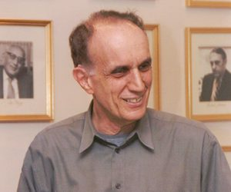
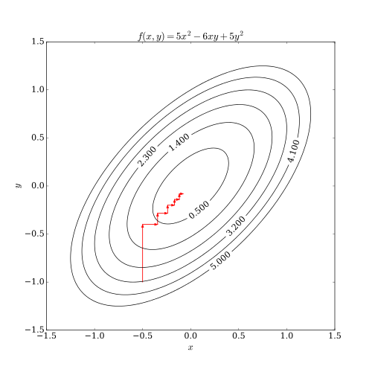
The LASSO — Algorithms
The issue of computation cost is one reason why LASSO did not get much attention at the beginning.
Tibshirani's supervisor, Efron solved the problem
LARS (least-angle regression) algorithm
Very efficient
Geometric insights
LASSO started being widely used
Coordinate descent algorithms are the mostly popular for solving LASSO nowadays
Less insights offered but simpler and more flexible
Bradley Efron (1938 - )
Notes:
Efficient algorithms are very important.

Slide 7
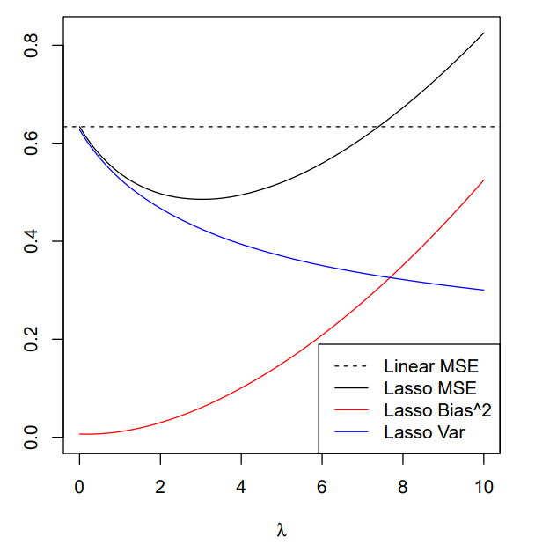
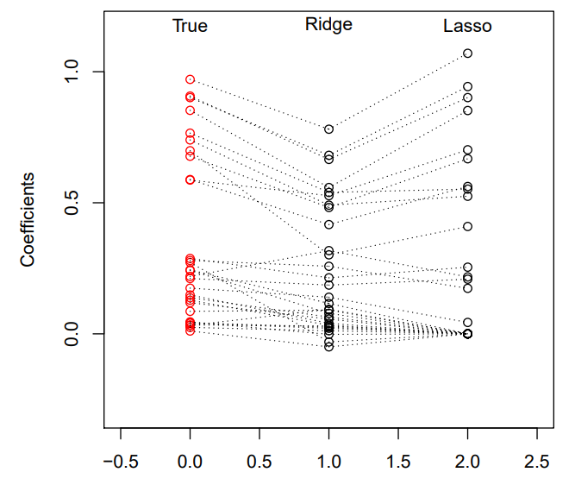
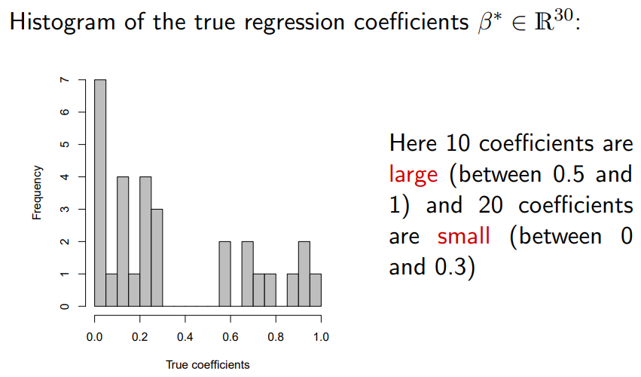
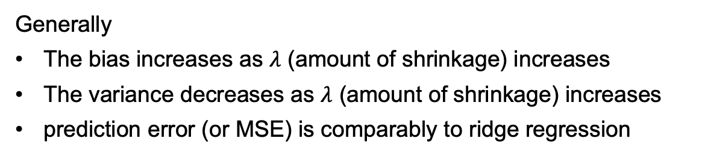
The LASSO — Example A
Generally
The bias increases as $λ$ (amount of shrinkage) increases
The variance decreases as $λ$ (amount of shrinkage) increases
prediction error (or MSE) is comparably to ridge regression

Slide 8
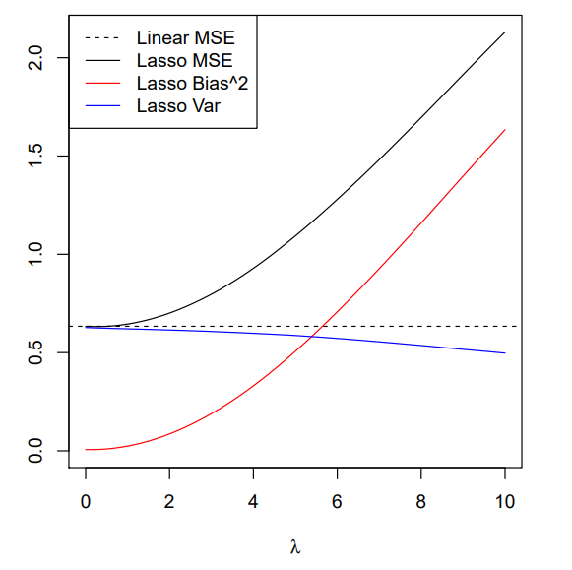
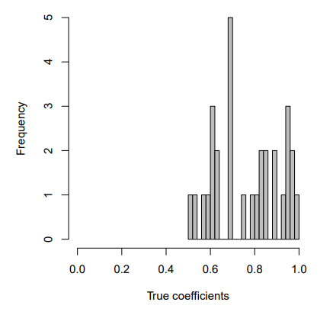
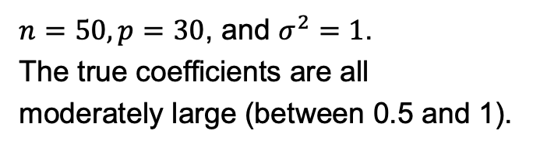
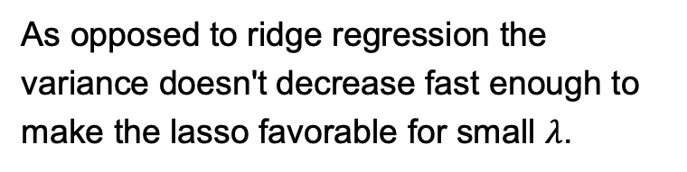
The LASSO — Example B
$n=50, p=30$, and $σ^{2}=1$.
The true coefficients are all moderately large (between 0.5 and 1).
As opposed to ridge regression the variance doesn't decrease fast enough to make the lasso favorable for small $λ$.

Slide 9
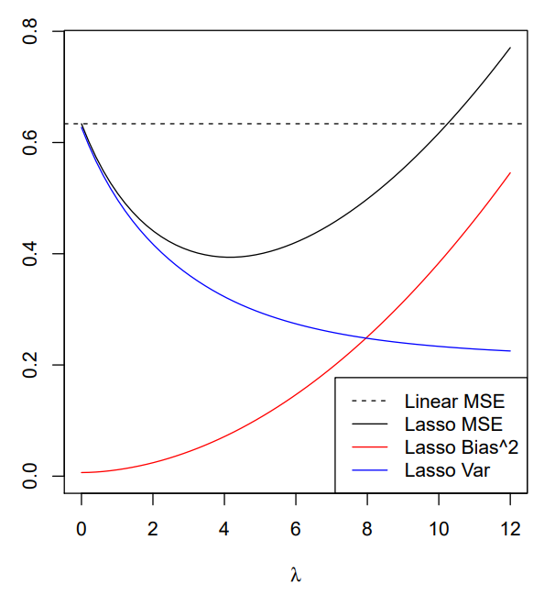
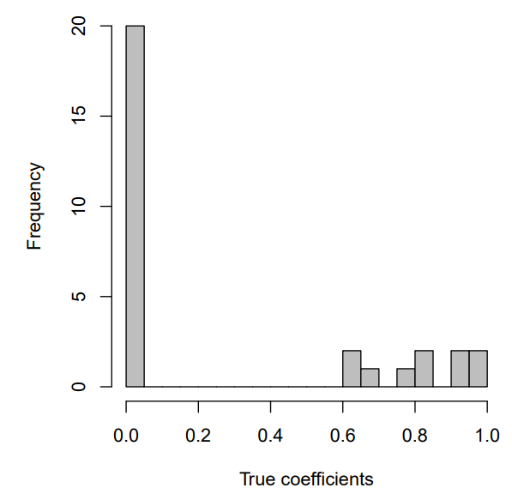
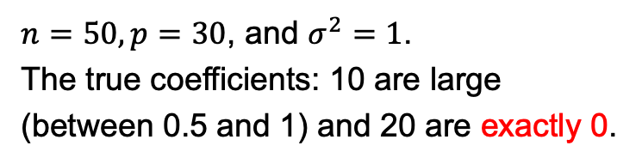
The LASSO — Example C
$n=50, p=30$, and $σ^{2}=1$.
The true coefficients: 10 are large (between 0.5 and 1) and 20 are exactly 0.
LASSO performs well (better than ridge regression).
Notes:
Home field of LASSO.

Slide 10
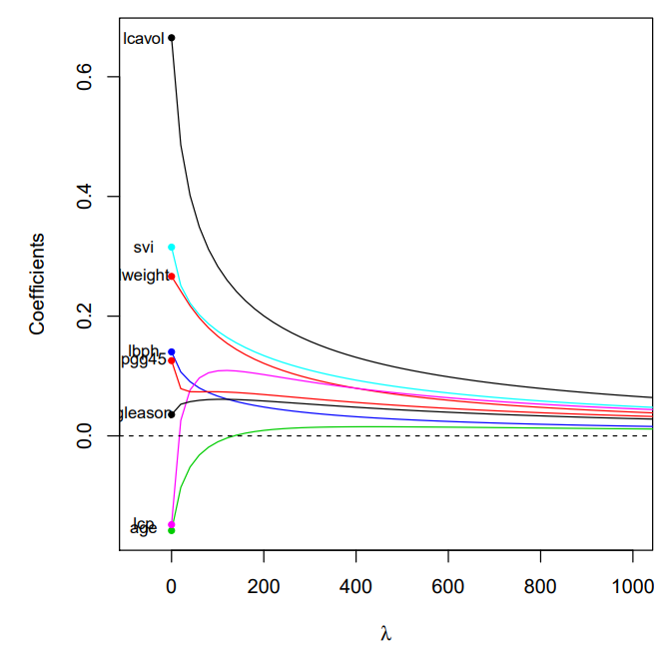
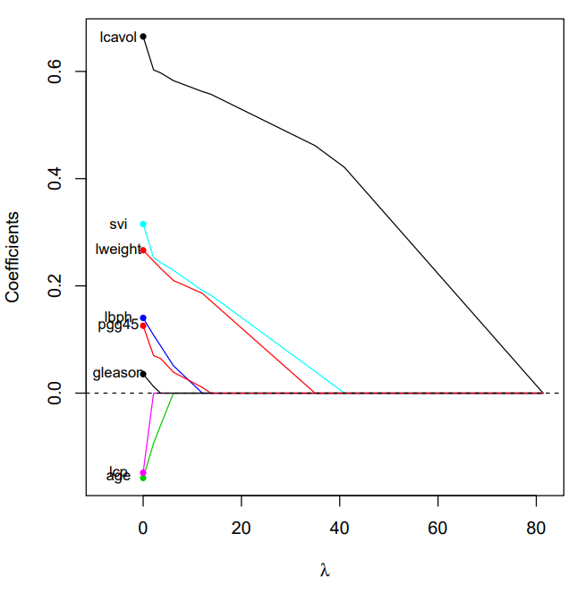
The LASSO — Advantage in interpretation
Example of the prostate cancer data :
Ridge
LASSO

Slide 11
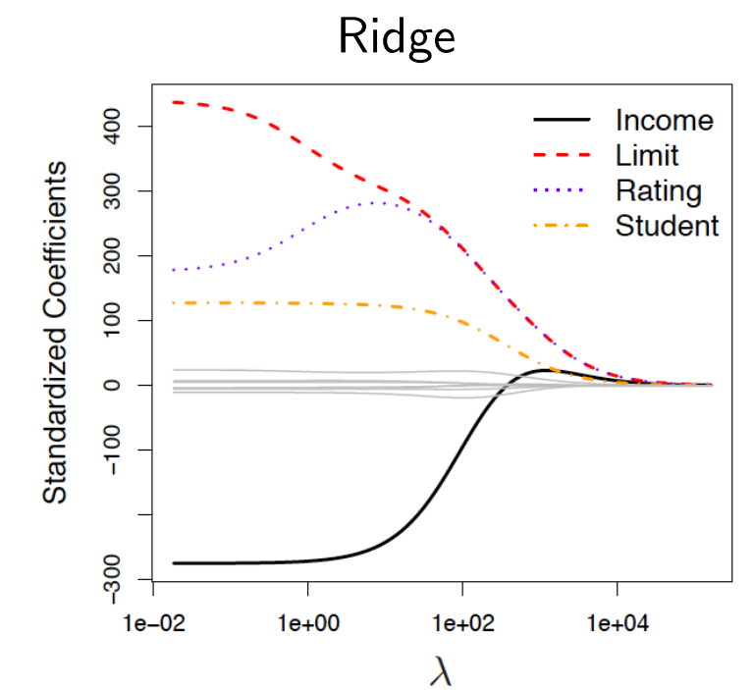
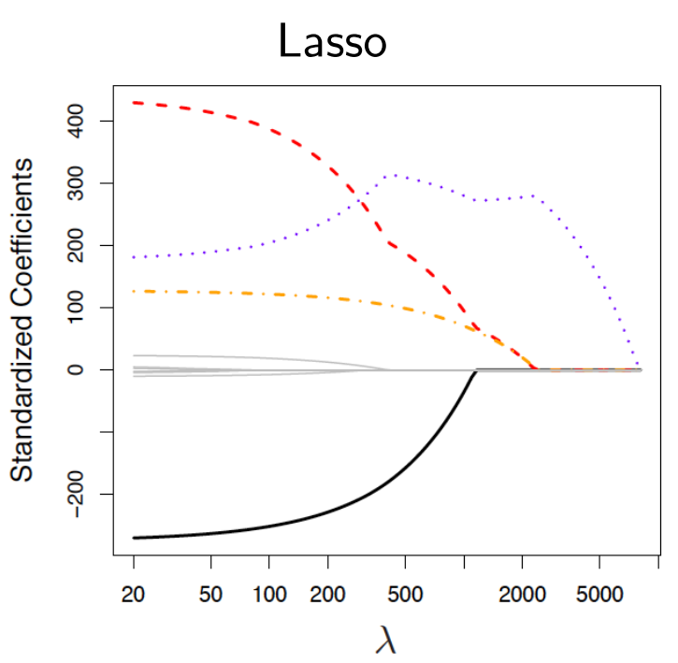
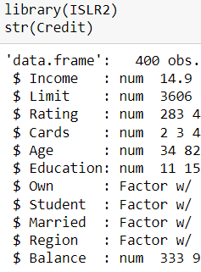
The LASSO — Advantage in interpretation
The credit data (available from library(ISLR2)):
response is average credit debt, predictors are income, limit (credit limit), rating (credit rating), student (indicator), and others
Notes:
LASSO retains the features that are more useful for prediction.

Slide 12
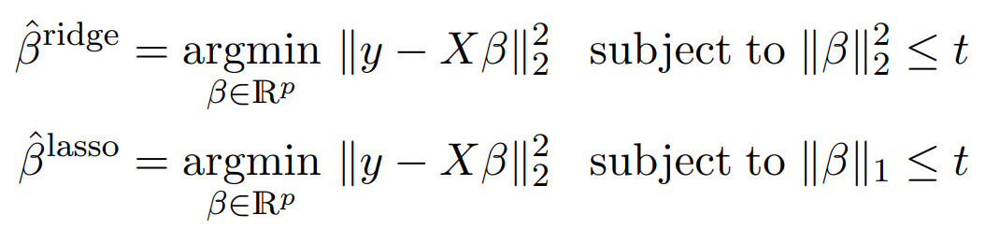
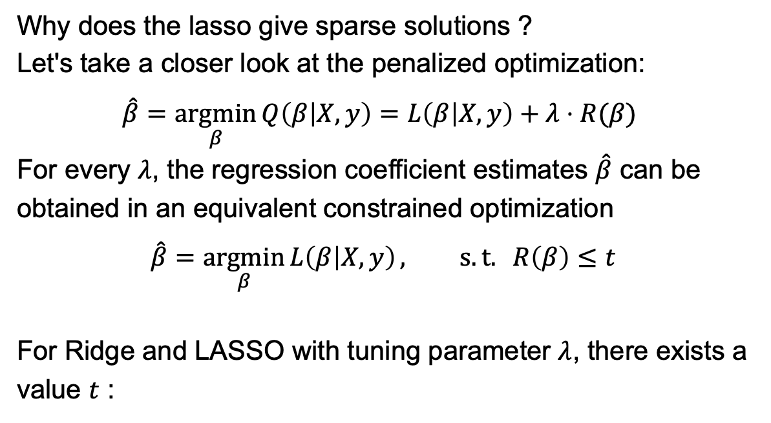
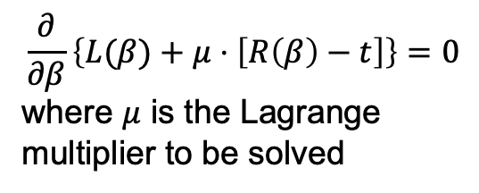
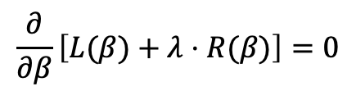
The LASSO — why sparsity ?
Why does the lasso give sparse solutions ?
Let's take a closer look at the penalized optimization:
$$\hat{β}=\underset{β}{argmin}{Q\left(β | X,y\right)=L\left(β | X,y\right)+λ⋅R(β) }$$
For every $λ$, the regression coefficient estimates $\hat{β}$ can be obtained in an equivalent constrained optimization
$$\hat{β}=\underset{β}{argmin}{L\left(β | X,y\right)}, s.t. R\left(β\right)≤t$$
For Ridge and LASSO with tuning parameter $λ$, there exists a value $t$ :
$$\frac{∂}{∂β}\left[L(β)+λ⋅R(β)\right]=0$$
$$\frac{∂}{∂β}\left\{L(β)+μ⋅\left[R\left(β\right)−t\right]\right\}=0$$
where $μ$ is the Lagrange multiplier to be solved

Slide 13
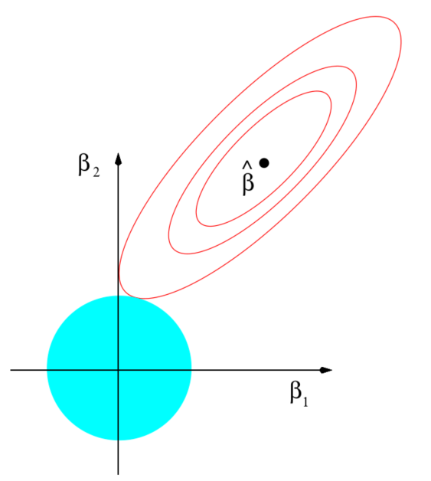
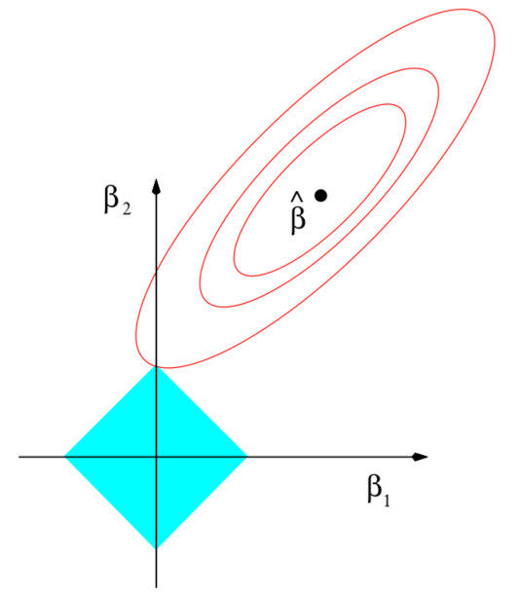
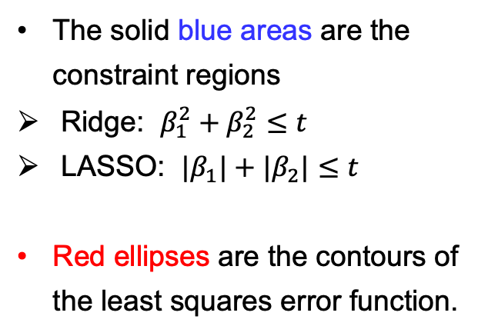
The LASSO — why sparsity ?
The solid blue areas are the constraint regions
Ridge: $β_{1}^{2}+β_{2}^{2}≤t$
LASSO: $|β_{1}|+|β_{2}|≤t$
Red ellipses are the contours of the least squares error function.
Ridge
LASSO
Notes:
Beta^hat is the OLS solution, minimizing the least square error.

Slide 14
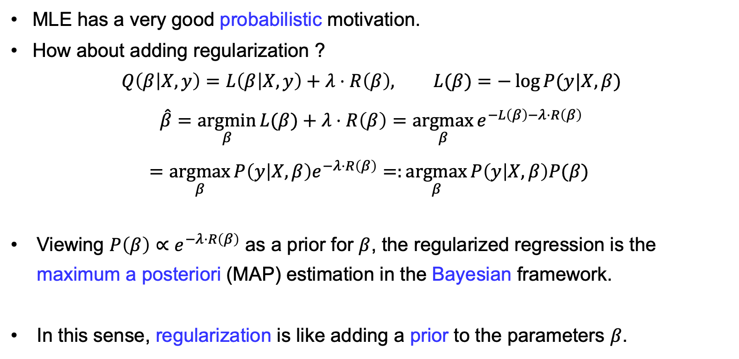
Probabilistic Interpretation
MLE has a very good probabilistic motivation.
How about adding regularization ?
$$Q\left(β | X,y\right)=L\left(β | X,y\right)+λ⋅R\left(β\right), L(β)=−\log{P(y|X,β)}$$
$$\hat{β}=\underset{β}{argmin}{L(β)+λ⋅R\left(β\right)}=\underset{β}{argmax}{e^{−L\left(β\right)−λ⋅R\left(β\right)}}$$
$$=\underset{β}{argmax}{P\left(y | X,β\right)e^{−λ⋅R\left(β\right)}}=:\underset{β}{argmax}{P\left(y | X,β\right)P(β) }$$
Viewing $P\left(β\right)∝e^{−λ⋅R\left(β\right)}$ as a prior for $β$, the regularized regression is the maximum a posteriori (MAP) estimation in the Bayesian framework.
In this sense, regularization is like adding a prior to the parameters $β$.

Slide 15
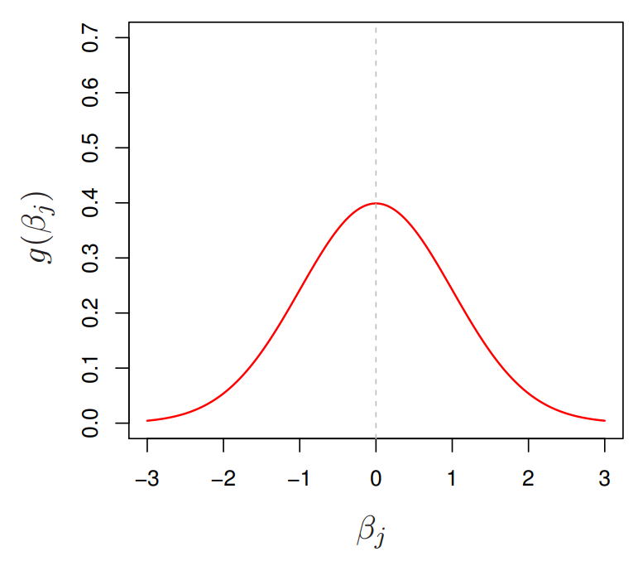
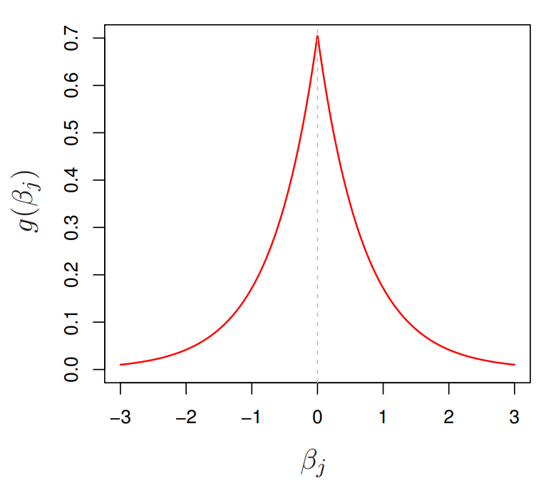
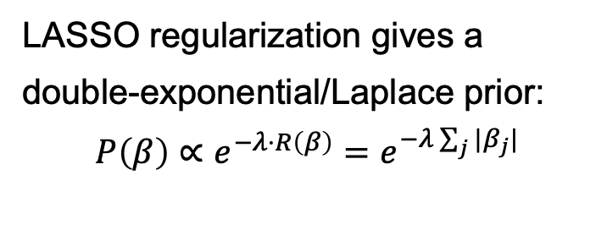
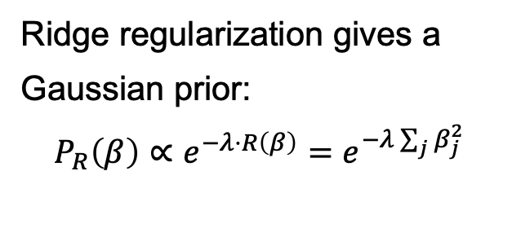
Probabilistic Interpretation
The LASSO prior encourages more zero coefficients than ridge.
Ridge regularization gives a Gaussian prior:
$$P_{R}\left(β\right)∝e^{−λ⋅R\left(β\right)}=e^{−λ\sum_{j}{β_{j}^{2}}}$$
LASSO regularization gives a double-exponential/Laplace prior:
$$P\left(β\right)∝e^{−λ⋅R\left(β\right)}=e^{−λ\sum_{j}{|β_{j}|}}$$

Slide 16
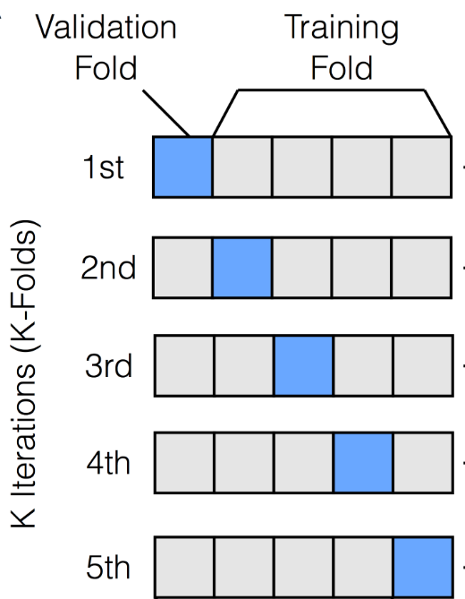
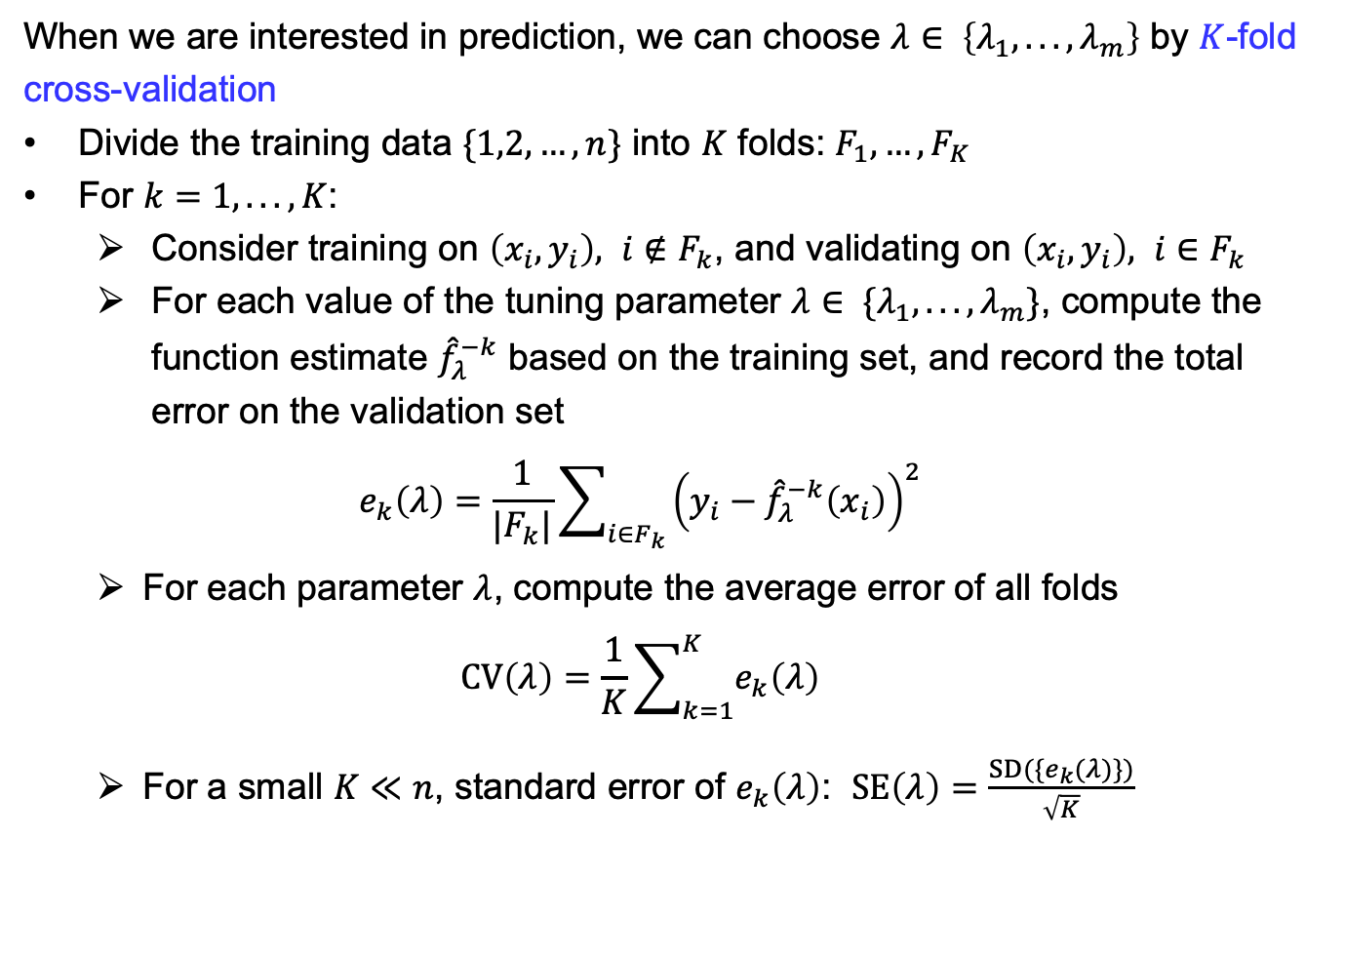
Choosing the tuning parameter $λ$
When we are interested in prediction, we can choose $λ∈ \left\{λ_{1}, . . . ,λ_{m}\right\}$ by $K$-fold cross-validation
Divide the training data $\{1,2,…,n\}$ into $K$ folds: $F_{1},…,F_{K}$
For $k=1, . . . ,K$:
Consider training on $\left(x_{i},y_{i}\right), i∉F_{k}$, and validating on $\left(x_{i},y_{i}\right), i∈F_{k}$
For each value of the tuning parameter $λ∈ \{λ_{1}, . . . ,λ_{m}\}$, compute the function estimate ${\hat{f}}_{λ}^{−k}$ based on the training set, and record the total error on the validation set
$$e_{k}\left(λ\right)=\frac{1}{|F_{k}|}\sum_{i∈F_{k}}{{\left(y_{i}−{\hat{f}}_{λ}^{−k}\left(x_{i}\right)\right)}^{2}}$$
For each parameter $λ$, compute the average error of all folds
$$CV\left(λ\right)=\frac{1}{K}\sum_{k=1}^{K}{e_{k}\left(λ\right)}$$
For a small $K≪n$, standard error of $e_{k}\left(λ\right)$: $SE\left(λ\right)=\frac{SD(\{e_{k}(λ)\})}{\sqrt{K}}$

Slide 17
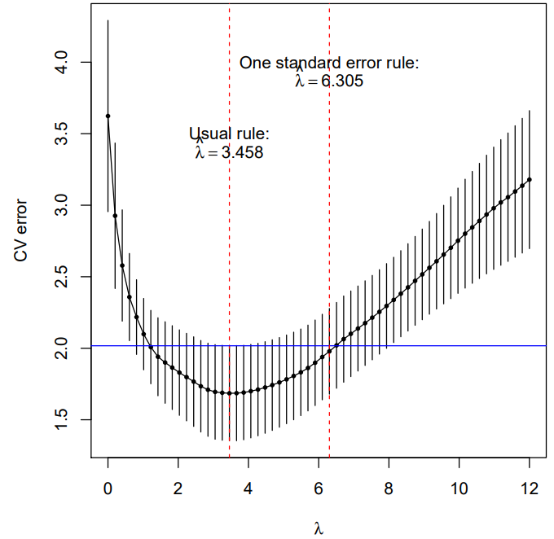
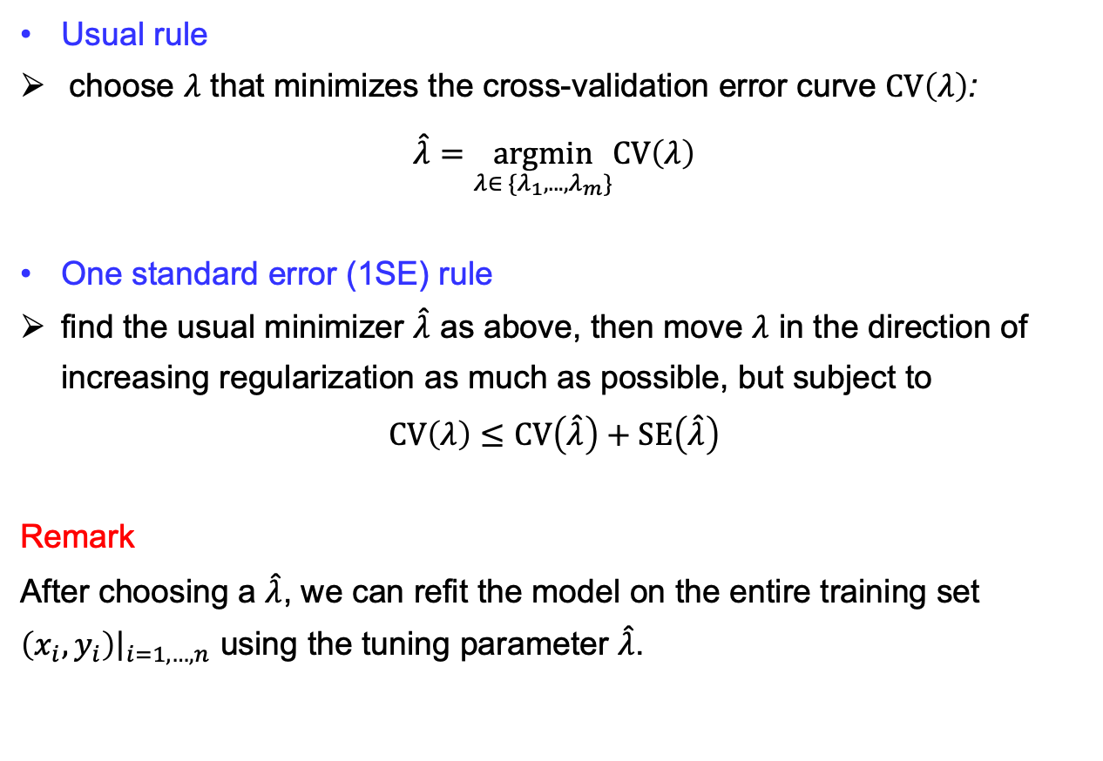
Choosing the tuning parameter $λ$
Usual rule
choose $λ$ that minimizes the cross-validation error curve $CV\left(λ\right)$:
$$\hat{λ}=\underset{λ∈ \{λ_{1}, . . . ,λ_{m}\}}{argmin}CV\left(λ\right)$$
One standard error (1SE) rule
find the usual minimizer $\hat{λ}$ as above, then move $λ$ in the direction of increasing regularization as much as possible, but subject to
$$CV\left(λ\right)≤CV\left(\hat{λ}\right)+SE\left(\hat{λ}\right)$$
Remark
After choosing a $\hat{λ}$, we can refit the model on the entire training set $\left(x_{i},y_{i}\right){\left.​\right|}_{i=1,…,n}$ using the tuning parameter $\hat{λ}$.

Slide 18
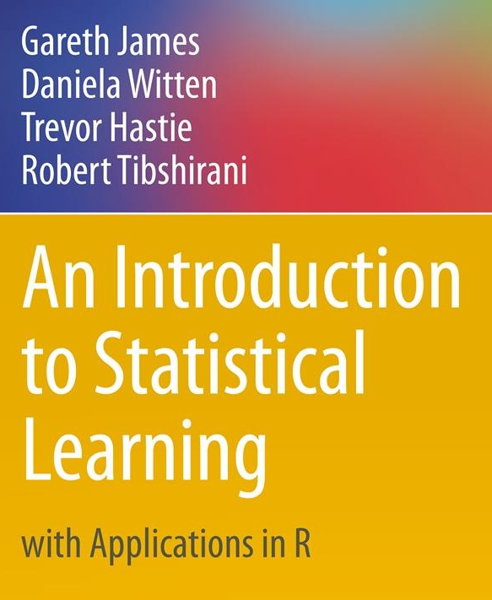
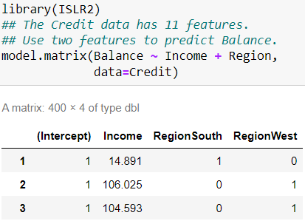
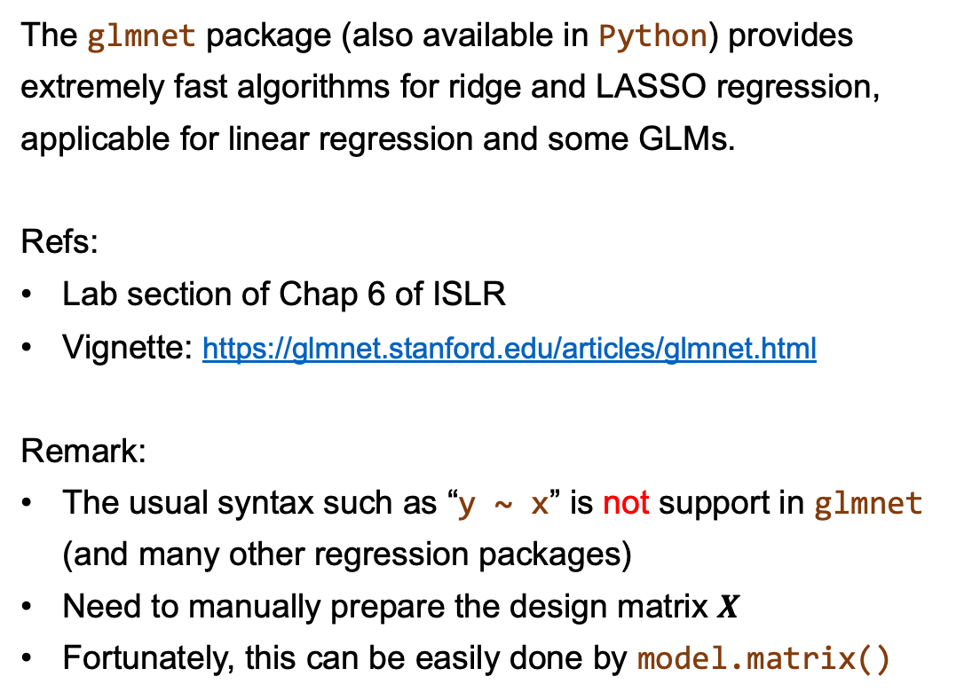
R Practical
The glmnet package (also available in Python) provides extremely fast algorithms for ridge and LASSO regression, applicable for linear regression and some GLMs.
Refs:
Lab section of Chap 6 of ISLR
Vignette: https://glmnet.stanford.edu/articles/glmnet.html
Remark:
The usual syntax such as “y ~ x” is not support in glmnet (and many other regression packages)
Need to manually prepare the design matrix $X$
Fortunately, this can be easily done by model.matrix()

Slide 19
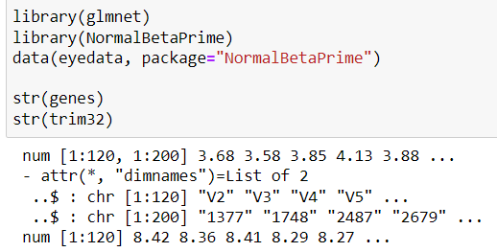
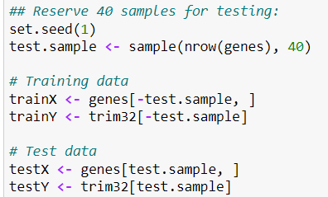
R Practical — Example of a gene expression data set
Taken from the microarray experiments of mammalian eye tissue samples of Scheetz et al. (2006).
The data set contains
gene expression data (200 genes for 120 samples)
gene expression levels of TRIM32
Target:
Predict the expression levels of TRIM32 (linked with a genetic disorder) from the expression levels of the 200 genes.
Notes:
Original paper: 18,976 gene expressions.

Slide 20
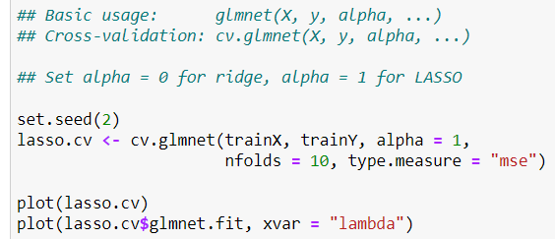
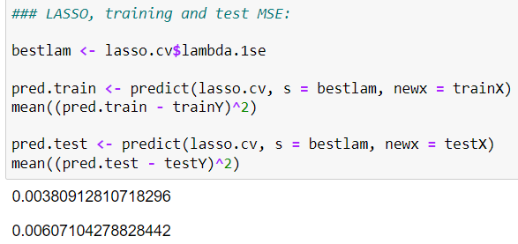
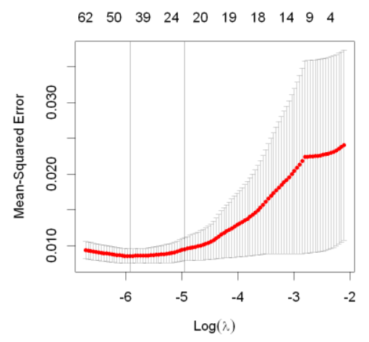
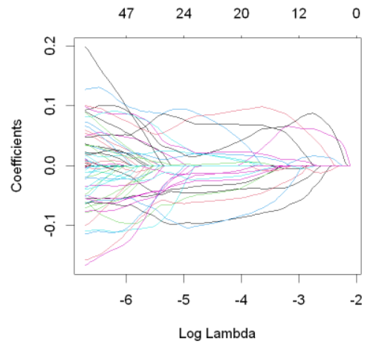


R Practical — Example of a gene expression data set
Notes:
Inappropriate to report R-squared.

Slide 21



R Practical — Example of a gene expression data set
Caution on interpretations:
Using these 22 features with the coefficients found by LASSO leads to a good predictive model.
It is incorrect to conclude that the selected features are the only underling working genes, or more effective than those not included. (Even though it is the case, you cannot conclude it from LASSO.)
To see this point, think about multicollinearity. Say LASSO selects $\{x_{i1},x_{i2}\}$. But it turns out that $\{x_{i7},x_{i8}\}$ are linear combination of $\{x_{i1},x_{i2}\}$. It this case it would be equally good to select $\{x_{i7},x_{i8}\}$.
Similar reasoning extends to the high-dimension setting $p>n$.
Using the 1SE rule,
LASSO select 22 features.

Slide 22











Extension — Elastic net and Group LASSO
Elastic net $≈$ ridge + LASSO
Variable selection ability (like LASSO)
Strictly convex and unique minimum (like ridge)
R practical: glmnet package
Group LASSO
The p predictors are divided into J groups
Variables in each group are penalized together
Genes in the same biological pathway
Dummy variables of the same categorical factor (ability to select a categorical variable, unlike LASSO)
R practical: grplasso package

Slide 23




To Summarize
In this course, we have seen
Fitting of distribution, generative models (Gaussian mixture, GANs, …)
Learn $P(X)$ from data $\{X_{i}\}$, or $P(X,y)$ from data $\{(X_{i},y_{i})\}$
Inference; Ability to sample new data $X$, or $X|y$
Discriminative models (linear regression, GLMs, …)
Learn $P(y|X)$ from data $\{(X_{i},y_{i})\}$; $P(X)$ is not modelled.
Good at prediction
Maximum likelihood estimation provides a unified framework for fitting in these statistical models. Ability to perform statistical inference, hypothesis testing, …
Hypothesis testing to assess the goodness-of-fit.
Improvement can be made by regularization (bias variance trade-off).
Notes:
Other generative models for data with response/labels: P(X, y)

Slide 24










Some Further Topics
Regression: more flexible models of the mean $f\left(X\right)=E(y|X)$
(the uncertainty of the data is still assumed, e.g., from exponential families.)
Generalized additive models (GAM)
(Fixed) basis functions $h_{jm}(X)$ to model nonlinear relations
Regularization to control model complexity
References:
Notes:
The more number of bases, the higher the complexity.

Slide 25






Some Further Topics
Regression: beyond modeling the mean $E(y|X)$
Generalized Additive Models for Location, Scale and Shape (GAMLSS)
The linear model assumptions
The GAMLSS assumptions
References:
https://www.gamlss.com/

Slide 26





Some Further Topics
Fixed basis functions $h_{jm}(X)$ to model complex functions:
$f\left(X\right)=\sum_{j=1}^{p}{\sum_{m=1}^{M_{j}}{β_{jm}h_{jm}}(X_{j})}$
Adaptive basis functions to model complex functions
$\left\{h_{k}\left(X\right)\right\}$: a learnable internal representation of $X$
Representation learning: one essence of deep learning

Slide 27
Thank you!

